Slide 1

3D PLANETARIUM SOFTWRE
Team name :Crew X

Slide 2
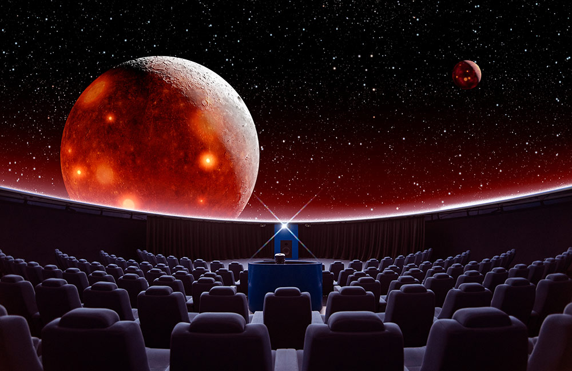
PROBLEM STATEMENT
The free space simulation that lets the user explore the universe in three dimensions. It shows a realistic sky in 3D, just like what one sees with the naked eye, binoculars or a telescope. The Ministry of Culture is developing many planetariums in the country and there is no OEM from India developing Planetarium software.

Slide 3
ABSTRACT

Slide 4
3D planetarium software is used to get information (position, rotation, velocity etc) about any planet/star in the galaxy. The user can explore the galaxy using a spaceship controlled by WASD/arrow keys, approach any star to know about its information. The features which make our software unique are:
User can change the timescale (slow or speed up time)
Learn about the planet information in the past and future
View the current satellite launched by any space organization in real time by obtaining its position, velocity etc from the database which will be updated by a PHP script using a formula of its expected path

Slide 5
APPROACH
Travel throughout the galaxy with a spaceship
Information of position, rotation, velocity will be displayed
Feature to change the timescale
Learn about the planet information in the past and future
View the current satellite launched, asteroid belts and space stations
Spawn exo planets in real time using database from NASA or so

Slide 6
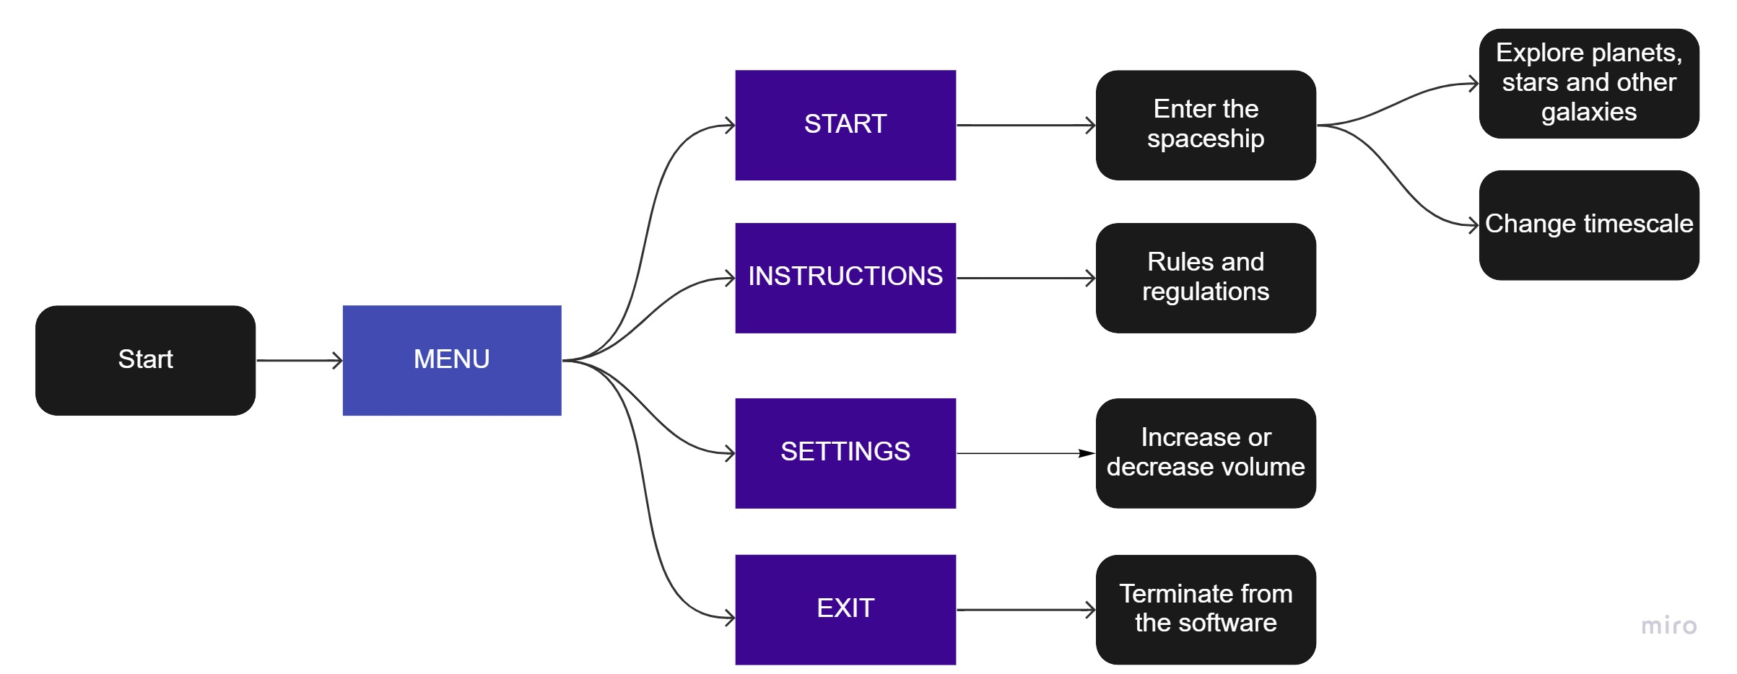
DATA FLOW DIIAGRAM

Slide 7
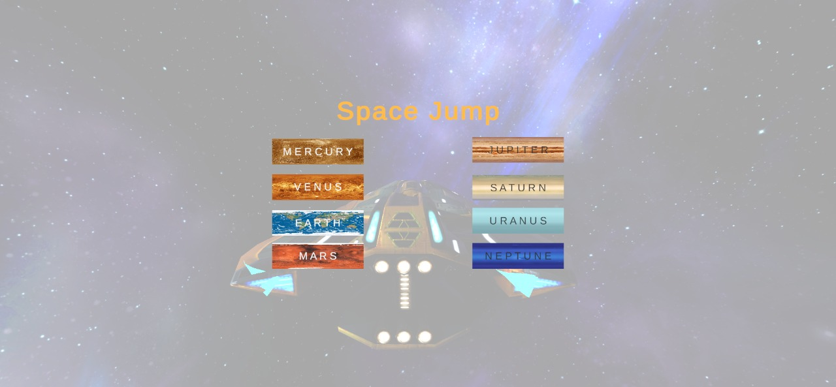
OBJECTIVE
Travel throughout the galaxy in a spaceship. Learn information about the planet and stars - position, rotation, velocity at any point in time. Slow or speed up time. Track satellites launched by space agencies in real time and the path they can take in future!
.

Slide 8


TECHNOLOGY STACK
Unity is a cross-platform game engine developed by Unity Technologies, first announced and released in June 2005 at Apple Worldwide Developers Conference as a Mac OS X game engine. The engine has since been gradually extended to support a variety of desktop, mobile, console and virtual reality platforms. It is particularly popular for iOS and Android mobile game development and is considered easy to use for beginner developers and is popular for indie game development.
Blender is a free and open-source 3D computer graphics software tool set used for creating animated films, visual effects, art, 3D-printed models, motion graphics, interactive 3D applications, virtual reality, and, formerly, video games. Blender's features include 3D modelling, UV mapping, texturing, digital drawing, raster graphics editing, rigging and skinning, fluid and smoke simulation, particle simulation, soft body simulation, sculpting, animation, match moving, rendering, etc.

Slide 9
FUTURE SCOPE
In this project ,the local database is created and being used for the storage , retrieval and modification of the data ,but cloud services can be used to do this instead.
Using more of Application Programming Interfaces(API’s) can help in better efficiency ,adaptability and customization.

Slide 10
Introduction to black holes ,white holes and dwarf planets and various other information regarding them gives better details and helps with good understanding about the planets, solar system, galaxy and many more.

Slide 11
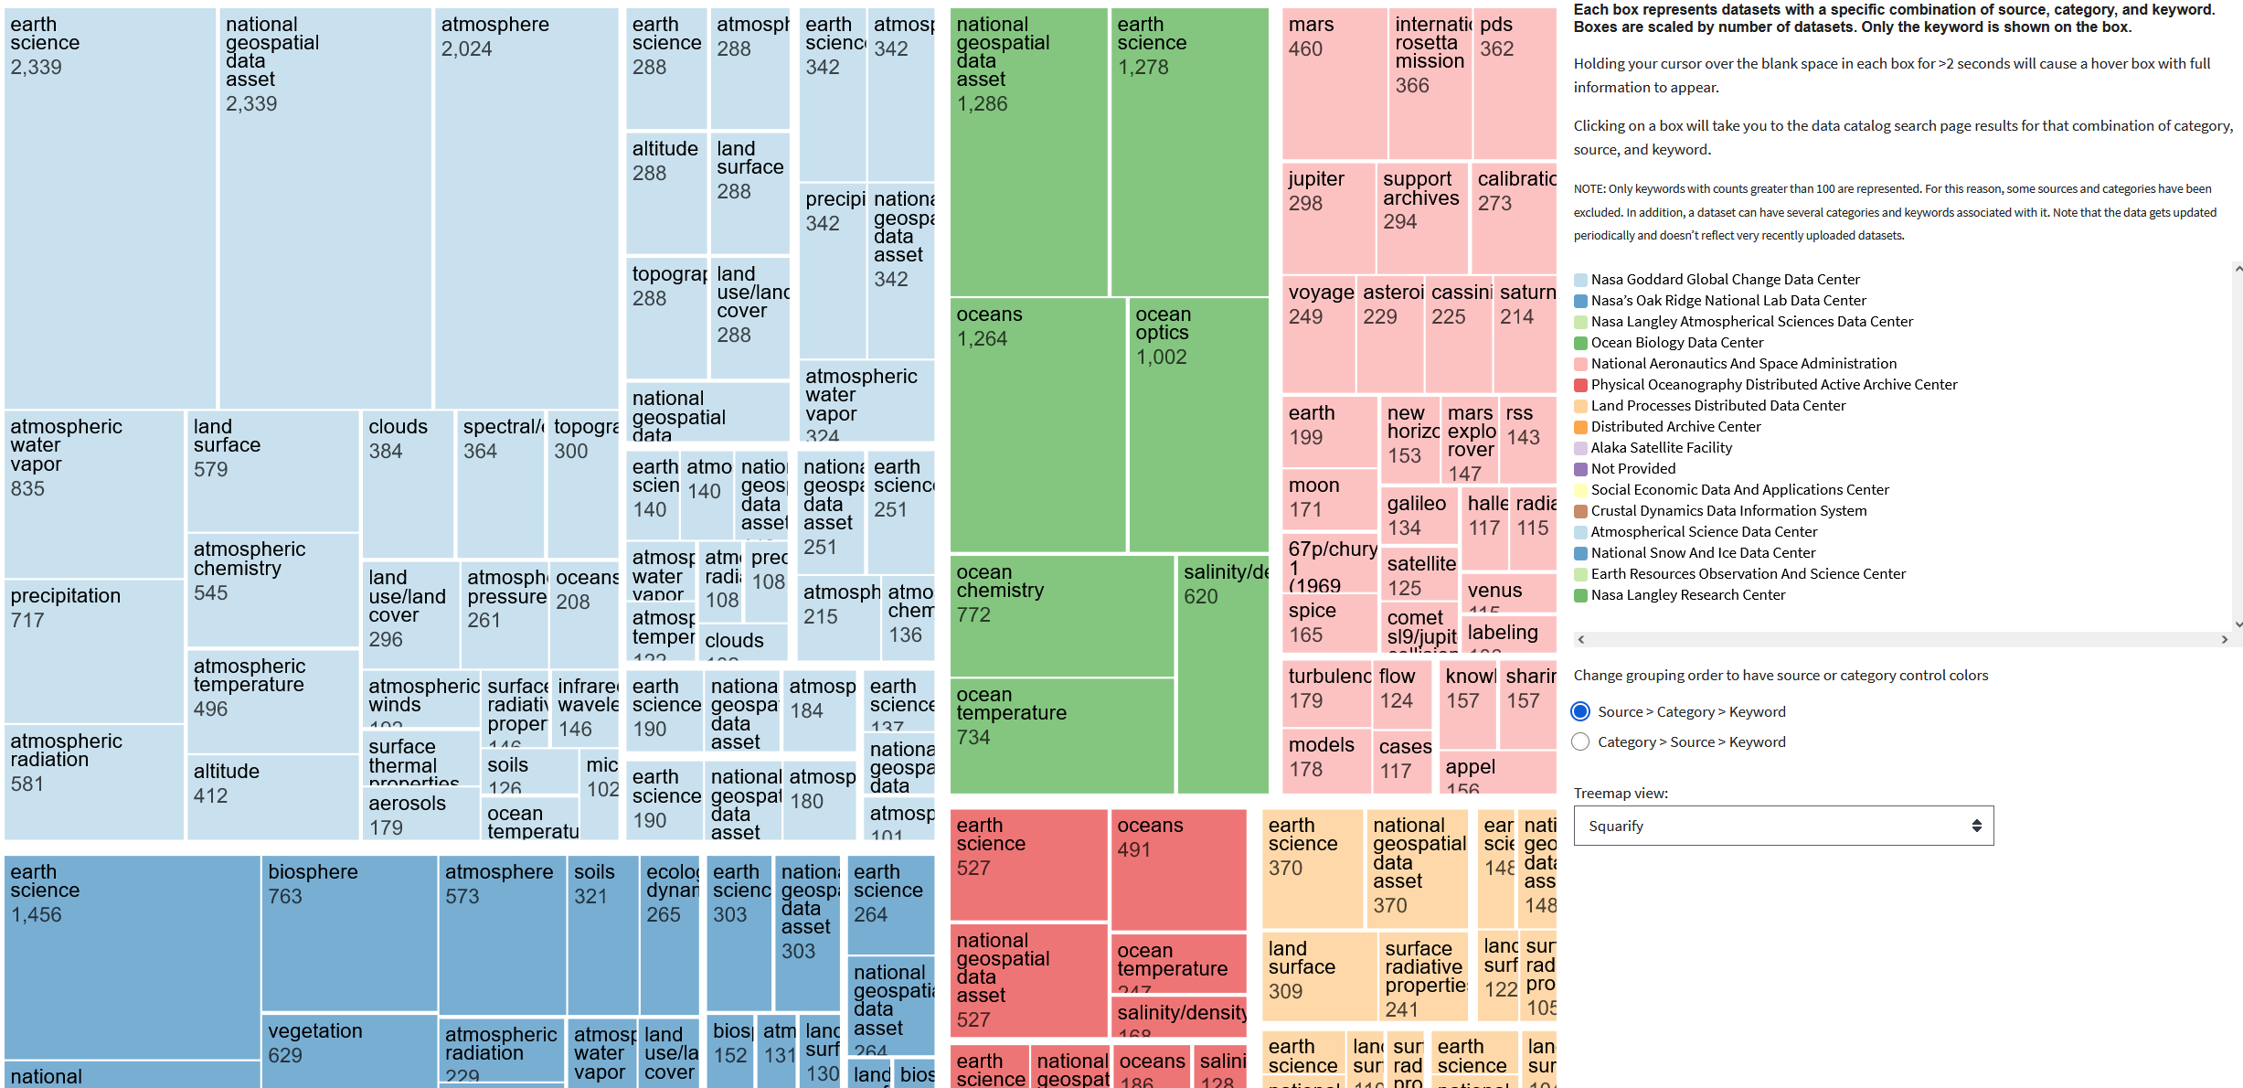
SCALABILITY
The local database used to store the information leads to an advantage of internet not being a necessary to run the software.
As all the details stored in the database has been taken from the NASA database ,it is accurate and relevant.

Slide 12
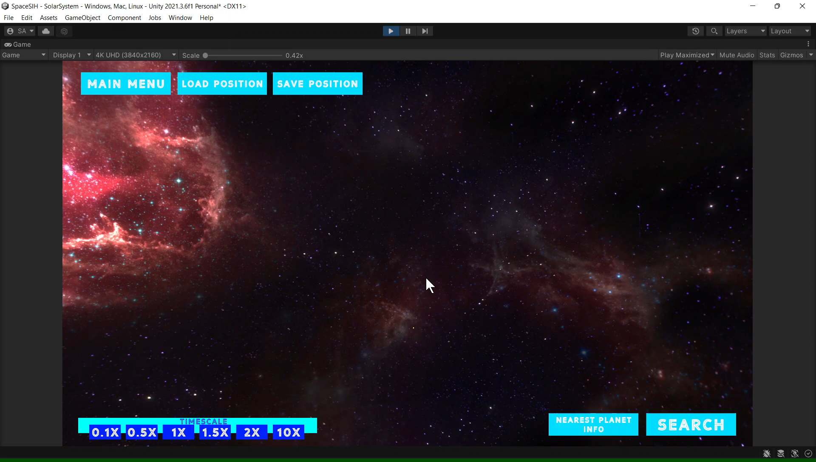
A glimpse of our software

Slide 13
INTRODUCING THE TEAM
SYED IBRAHIM MAAZ (TEAM LEADER)
DEEPTHI GIRISH
HARSHITHA JK
POORNIMA R
SHASHANK S
SHRAVYA SURESH
DR. ANITHA J (MENTOR)

Slide 14
Thank you!

